Slide 1
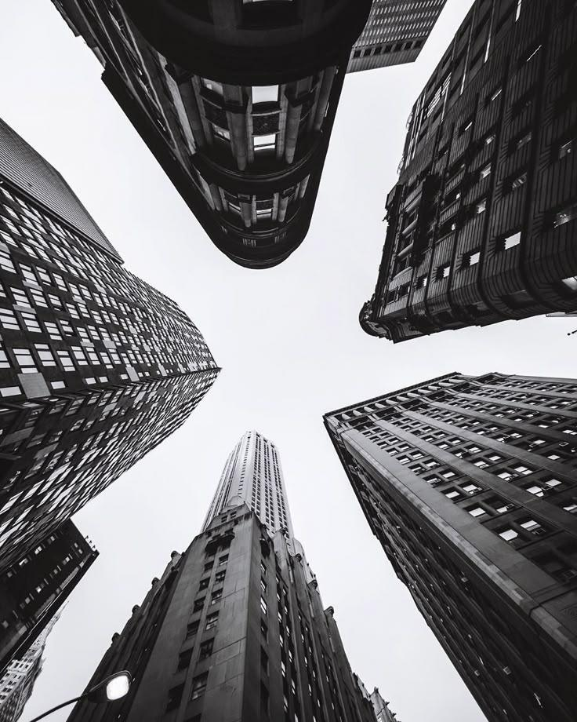
Artist House- Model Making
Presented by:
Minahil Qazi
Department of Architecture

Slide 2
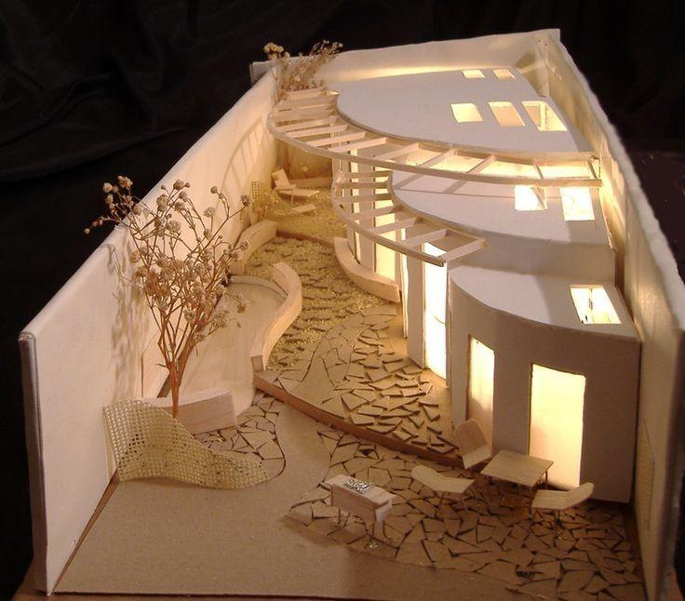
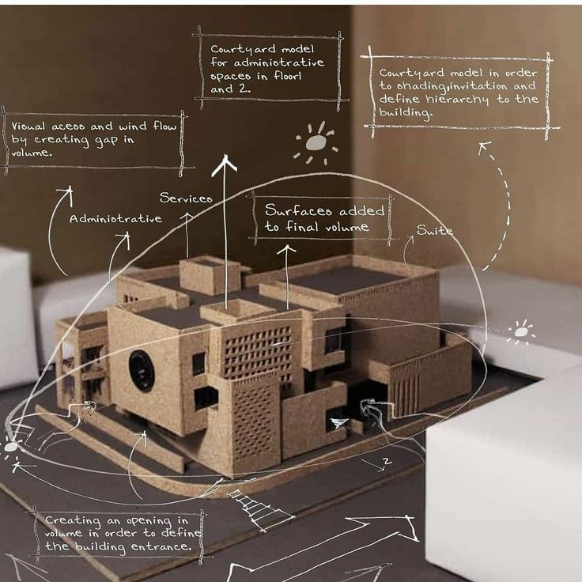
Model Making
Model making is a way to translate architectural ideas into a physical form.
It helps visualize spaces, levels, and movement before actual construction.
Through scale and form, the model shows how light, openness, and circulation work together.

Slide 3
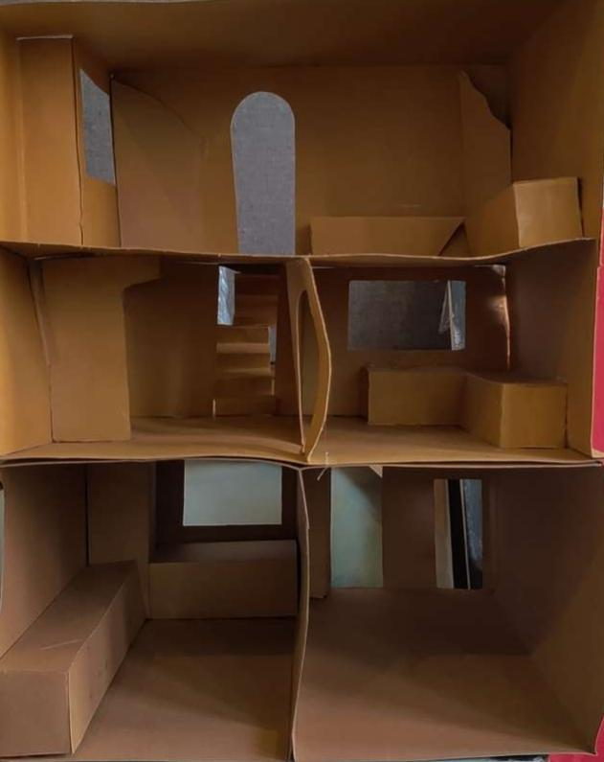
Artist House- Spatial Organization
This space is designed according to my Artist “Anna Molka Ahmed”.
The model represents a multi-level artist house with open and connected spaces.
Arches and apertures are used to allow light and visual continuity between levels.
The design focuses on openness, reflecting an artist’s need for movement and interaction.
Vertical circulation is shown through internal stairs, connecting private and semi-private zones.
The absence of furniture keeps the focus on pure space and form.

